Slide 1
GraphQL for Android
The code works, I don't know why

Slide 2
What is GraphQL
From the frontend point of view it is a query language for data APIs, and for the backend it is a runtime layer that needs to be implemented.
It is open source and was developed by Facebook, it is currently maintained by a large community of companies and individuals around the world.

Slide 3
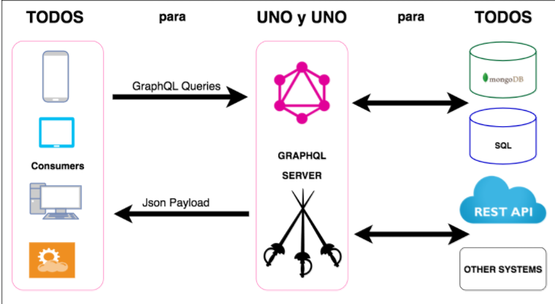
How works?

Slide 4
and about Android?
Apollo Android is a GraphQL client that generates type-safe Kotlin models from your GraphQL queries. It also handles parsing and caching so you can focus on what matters most to your users and build beautiful mobile apps.

Slide 5



What I need?
Android Studio Plugin
Gradle Dependencies
Server URL
Define packageName
We need the path main/graphql
The Scheme *.dsl
The query files

Slide 6
Resources
https://github.com/chefest/GraphQL-RickMorty
https://studio.apollographql.com/public/rick-and-morty-a3b90u/variant/current/explorer

Slide 7
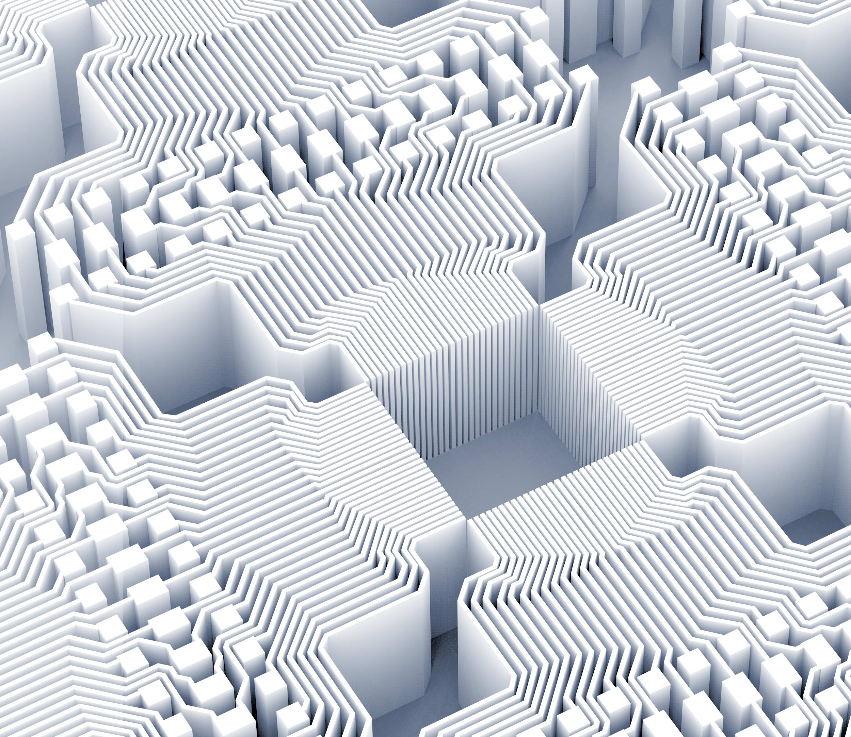
¡Thanks!
It's not a bug, it's a feature

